Slide 1
SmartShop AI
Instructor: Your Name

Slide 2
Welcome to today’s class, before we begin,
pop into the chat:
Your Name
💬
👷
Designation
👤
Location
🏠
🏢
Company
Notes:
Check how many students and adapt to typed in responses or poll, as needed

Slide 3
Success Hacks
Be prepared for the class by watching the warm-up/pre-class videos shared if any
Attend every live class on Sunday
Participate in the class
Practice! Experiment! Become an Expert!!!
Keep your goal in mind
Consistency is the key
Be patient with yourself !
Notes:
While explaining, plz mention that these pre videos are mandatory and watching them before the class would increase their understanding & hence improve their learning experience.
While explaining plz mention that these post class videos are not mandatory and don't have any dependency on further classes

Slide 4
IK Support Features
Uplevel - contains all the learning resources - videos, reading materials, project files
Discord community for peer learning
TAs to help answer the queries in the live class
Use academic support (SSAs) for any support/advise you want
Support tickets - Raise them any time you want any clarifications/ tech concerns , etc

Slide 5
Today’s Agenda
Recap & Motivation
Prerequisites & Problem Statement
Outcome
Dataset
Tools Used
Grading Rubrics
How the 8-weeks look like

Slide 6


What happened before?
4 weeks of Live-Guided Foundation Project.
Laid the foundation for project building with emphasis on GenAI
Instructor led the way, you followed!!!
Notes:
-> Hope you all had a nice time during your 4 weeks of live guided project. Now in the upcoming session you have to do an 8-week self paced project. -> Everyone please comment down your reason for choosing this pathway.

Slide 7


What is going to happen now?
8 weeks of Self-Led Breakthrough Project.
You will be driving the project with some assistance from the instructor!!!
Primarily driven through YOU!
Notes:
-> Hope you all had a nice time during your 4 weeks of live guided project. Now in the upcoming session you have to do an 8-week self paced project. -> Everyone please comment down your reason for choosing this pathway.

Slide 8

Don’t worry!
We are here to help at your every step !
But, how???

Slide 9
Ik’s support for you!
We have designed adequate instructional and technical support for you in the form of:
Weekend Live Sessions: Get a picture of your weekly milestones, and get guidance on how to attempt those. Also discuss past progress and get feedback from your instructor and fellow peers. This is scheduled for every week for the next 8 weeks
1:1 Connects with Project Mentors: For each project, we have assigned dedicated project mentors to help you with project domain specific queries. To access 1:1 connects, raise a ticket on Uplevel. You can avail upto 5 1:1 connects in the next 8 weeks.
Technical Coaching Sessions (1:n) : In this session, you’ll be getting your technical doubts resolved form the instructor. They are available once every 2 weeks (2nd, 4th, 6th and 7th week)
Notes:
Please check the last slide to know when you can utilise which feature.

Slide 10
Structure of sessions for the next 8 weeks!
Week (Today → Week -1 ) | Sunday Live Sessions | Coaching Sessions | 1<>1 Sessions
Week - 1 | ✅
Week - 2 | ✅ | ✅
Week - 3 | ✅
Week - 4 | ✅ | ✅
Week - 5 | ✅
Week - 6 | ✅ | ✅
Week - 7 | ✅ | ✅
Week - 8 | ✅
You can avail
upto 5 sessions
in these 8 weeks
PRO TIP:
Availing it in the 2nd or 3rd week gives you a good start!!!

Slide 11

Is this all??????
Wait!!!! There’s more………

Slide 12
Ik’s support extends beyond instructional support…
What more????
Instructions to plan your project milestones
Coding notebook templates for an easy start for every milestone
Additional resources if you get stuck somewhere
Milestone completion checklist (every 2 weeks) to track your progress and know your challenges.
AWS credits for deployment support.
And much more…
Notes:
Please check the last slide to know when you can utilise which feature.

Slide 13
How will the Gen AI Project help in the
Career Growth

Slide 14




Need of the hour!!!
Cutting Edge technology called Agentic AI
Industry-Relevant Skills for High-Demand Roles
Building Scalable & Autonomous AI Solutions
Adequate project building skills for the breakthrough project

Slide 15
Check - Points
01
✅ Project Progress Review
✅ Dataset Preparation & Validation
✅ Agents Implementation Check
✅ Interim Documentation Review
Week 1st -Week 5th
02
✅ Crew AI Orchestration Setup
✅ API & Backend Setup – FastAPI implementation review
✅ Final Deployment and UI SetUp
✅ Final Review and Presentation
Week 6th -Week 8th
Notes:
Assure them not to worry about the technical jargons. We will decode them in sometime.

Slide 16
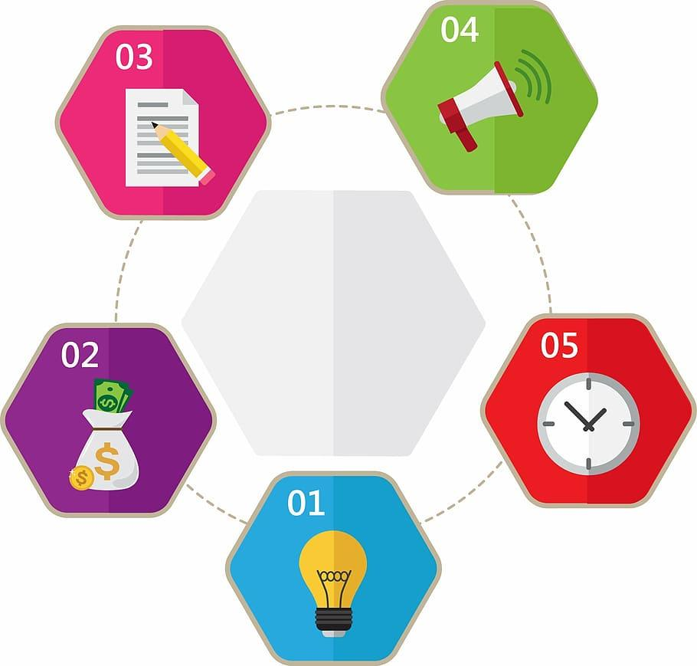
Outcome of Week - 1
Prepare a mind map
Know that this is a self - lead project
Prepare a document where you note down the next steps, The tools which you will use and the process you will follow to make your successive sessions successful.
Utilise the 1<>1 connect by raising the ticket in week - 1 and get your doubts resolved by content expert.
Notes:
Assure them not to worry about the technical jargons. We will decode them in sometime.

Slide 17
Let’s understand the problem statement that lies in front of us in detail.
…. To be solved in 8 weeks

Slide 18

Prerequisites
Technical Skills Required:
Must-Know:
Python, SQL & Databases
Basics of LLMs such as Prompt engineering
Good-to-Know:
LangChain or Similar Frameworks
Vector Databases
Cloud Deployment, GenAI Ecosystem
Notes:
Assure them not to worry about the technical jargons. We will decode them in sometime.

Slide 19

Problem Statement
Accessing personalized and efficient shopping experiences remains a challenge for many e-commerce platforms.
Traditional AI assistants provide generic recommendations and lack real-time, context-aware assistance for buyers.
Let’s build SmartShop AI, an intelligent, Multi-Agent e-commerce assistant leveraging LLMs, Pydantic AI to provide personalized shopping insights, real-time price comparisons
Notes:
Assure them not to worry about the technical jargons. We will decode them in sometime.

Slide 20
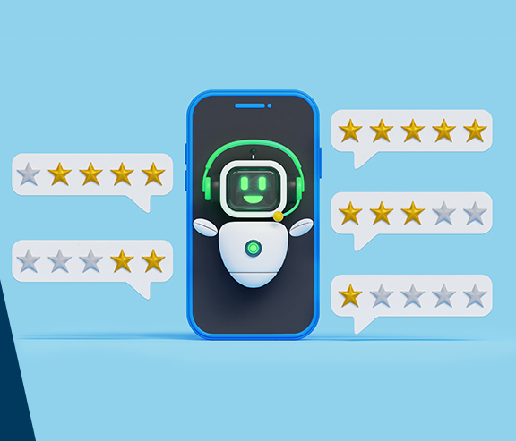
Project Features
Will build an AI-powered e-commerce assistant using LLMs and Pydantic AI to provide personalized shopping insights.
Will implement multi-agent AI using Pydantic AI to delegate specialized tasks such as review summarization, price comparisons, and product discovery.
Will deploy a FastAPI-based backend for seamless query handling, ensuring efficient and scalable customer assistance.
Notes:
Assure them not to worry about the technical jargons. We will decode them in sometime.

Slide 21















Tools Used
Notes:
Assure them not to worry about the technical jargons. We will decode them in sometime.

Slide 22

Dataset
Product Catalog Dataset
Contains product names, descriptions, prices, brands, categories, and images.
Used for: Recommendations, price comparisons, and product search.
Customer Reviews Dataset
Includes customer reviews, ratings, timestamps, and sentiment labels.
Used for: Review summarization and sentiment analysis.
Notes:
Assure them not to worry about the technical jargons. We will decode them in sometime.

Slide 23
Dataset
Store Policies Dataset
Contains return/exchange policies, refund rules, shipping details, and store FAQs.
Used for: Automating customer support queries.
Notes:
Assure them not to worry about the technical jargons. We will decode them in sometime.

Slide 24
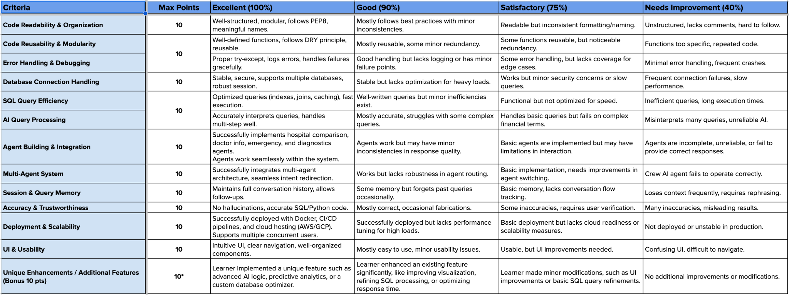
Grading Rubrics
SmartShop AI | Grading_Rubrics
Notes:
Assure them not to worry about the technical jargons. We will decode them in sometime.

Slide 25
How will we build this in the following
8 weeks?

Slide 26
8 Week Plan
01
✅ Overview of Projects and real-world applications
✅ Project Walkthroughs: Problem statement, Tech stack, Datasets, Expected outcomes
✅ Milestone Breakdown & Project Documentation Presentation
✅ Final Project Documentation
Project Initialization
& Fundamentals
02
✅ Development Environment Setup
✅ ✅ Explore customer reviews, FAQ, and store policy datasets.
✅ Store dataset representation in models.py and db.py.
✅ Database Hosting – Deploy MySQL on AWS/DigitalOcean
Dataset Exploration

Slide 27
8 Week Plan
03
✅ Build Coordinator Agent for query handling.
✅ Implement Review Summarization Agent with sentiment analysis.
✅ Define Pydantic models for AI agent responses.
✅ Connect agents for coordinated response generation.
AI Agent Implementation
04
✅ Develop Product Recommendation, Pricing, and FAQ Agents.
✅ Expand sample data and optimize agent interactions.
✅ Improve agent coordination for seamless query handling.
✅ Test and refine prompt engineering.
Expand AI Agents

Slide 28
8 Week Plan
05
✅ Implement LLM evaluation script for agent testing.
✅ Fine-tune FAQ & policy response agents.
✅ Optimize responses through prompt tuning.
✅ Introduce logging and API rate limiting for monitoring.
Evaluation & System Tuning
06
✅ Develop FastAPI router for processing queries.
✅ Integrate AI agents into a REST API endpoint.
✅ Implement caching and optimize API performance.
✅ Prepare deployment environment on Hugging Face/AWS/GCP.
FastAPI Integration & Deployment Prep

Slide 29
8 Week Plan
07
✅ Structure code using clean architecture principles
✅ Develop a Fast API backend on Hugging Face
✅ Create & integrate frontend interface
✅ Dockerize & set up CI/CD pipeline
Deployment and UI Integration
08
✅ Final Presentation with Instructor Review & Peer Review
✅ Final Deployment Checks
✅ Interview Readiness Viva
Final Presentation &
Interview Readiness

Slide 30






8 Week Plan | Outcome
Dataset Exploration
Review Summarization & Sentiment Analysis
API Development
& Deploy Prep
Product
& Pricing Agents
Building Multi-Agent System
UI/UX Integration
&
Deployment
Notes:
Assure them not to worry about the technical jargons. We will decode them in sometime.

Slide 31
What you need to do this week?
01
Project Initialization & Fundamentals
✅ Document Your Approach
Use the provided template to outline your plan for building the project.
Research tools, technologies, and best practices.
Template
✅ High-Level Design
Define the architecture (tentative) of your app.

